Slide 1
Design Pattern in .NET

Slide 2
Constructivism Topics
What is the Design Pattern?
What is the role of Design Pattern in Software Development?
What is the relationship between OOP (Object Oriented Programming) and Design Pattern?
What are Pros and Cons of Design Pattern?

Slide 3
Objectives
Overview about Design Pattern
Why must use Design Pattern?
Explain about Singleton Pattern
Explain about Factories Pattern
Explain about Abstract Factory Pattern
Explain about Builder Pattern
Explain about Prototype Pattern
Explain about Observer Pattern
Demo about Factories Method, Prototype Pattern and Singleton Pattern in .NET applications

Slide 4
Understanding Design Patterns
A design pattern provides a general reusable solution for the common problems that occur in software design
A design pattern isn't a finished design that can be transformed directly into code. It is a description or template for how to solve a problem that can be used in many different situations
Design patterns are programming language independent strategies for solving a common problem. That means a design pattern represents an idea, not a particular implementation

Slide 5
Understanding Design Patterns
Design patterns are not meant for project development. Design patterns are meant for common problem-solving and whenever there is a need, we have to implement a suitable pattern to avoid such problems in the future
The pattern typically shows relationships and interactions between classes or objects
By using the design patterns we can make our code more flexible, reusable, and maintainable
The Gang of Four (GoF) patterns are generally considered the foundation for all other patterns. They are categorized in three groups: Creational, Structural, and Behavioral

Slide 6
Why use Design Pattern?
Design patterns can speed up the development process by providing tested, proven development paradigms
Effective software design requires considering issues that may not become visible until later in the implementation
Reusing design patterns helps to prevent subtle issues that can cause major problems and improves code readability for coders and architects familiar with the patterns

Slide 7
Why use Design Pattern?
Often, we only understand how to apply certain software design techniques to certain problems. These techniques are difficult to apply to a broader range of problems
Design patterns provide general solutions, documented in a format that doesn't require specifics tied to a particular problem
Patterns allow developers to communicate using well-known, well understood names for software interactions. Common design patterns can be improved over time, making them more robust than ad-hoc designs

Slide 8
Introduction to GoF Patterns
Creational Design Patterns
These design patterns are all about class instantiation or object creation
These patterns can be further categorized into Class-creational patterns and object-creational patterns
While class-creation patterns use inheritance effectively in the instantiation process, object-creation patterns use delegation effectively to get the job done
Creational design patterns are the Singleton, Factory Method, Abstract Factory, Builder, and Prototype
Structural Design Patterns: Adapter, Bridge, Composite, Decorator, Facade, Flyweight, Private Class Data, and Proxy
Behavioral Design Patterns: Chain of responsibility, Command, Interpreter, Iterator, Mediator, Memento, Null Object, Observer, State, Strategy, Template method and Visitor
Notes:
Gang of Four

Slide 9
Creational Design Patterns
The following five patterns are concerned with the instantiation of objects:
Singleton: A pattern for enforcing only one instance of a class
Factory Method: A pattern for creating objects derived from a class where the specific class is determined at runtime
Abstract Factory: A pattern for the creation of objects belonging to a family of classes. The specific object is determined at runtime
Builder: A useful pattern for more complex objects where the construction of the object is controlled externally to the constructed class
Prototype: A pattern for copying or cloning an object

Slide 10
Singleton Pattern

Slide 11
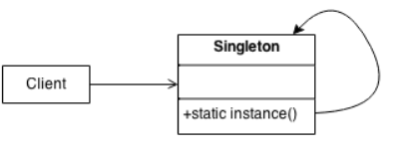
Singleton Pattern
Defines an Instance operation that lets clients access its unique instance. Instance is a class operation
Responsible for creating and maintaining its own unique instance
Make the class of the single instance responsible for access and "initialization on first use". The single instance is a private static attribute. The accessor function is a public static method

Slide 12
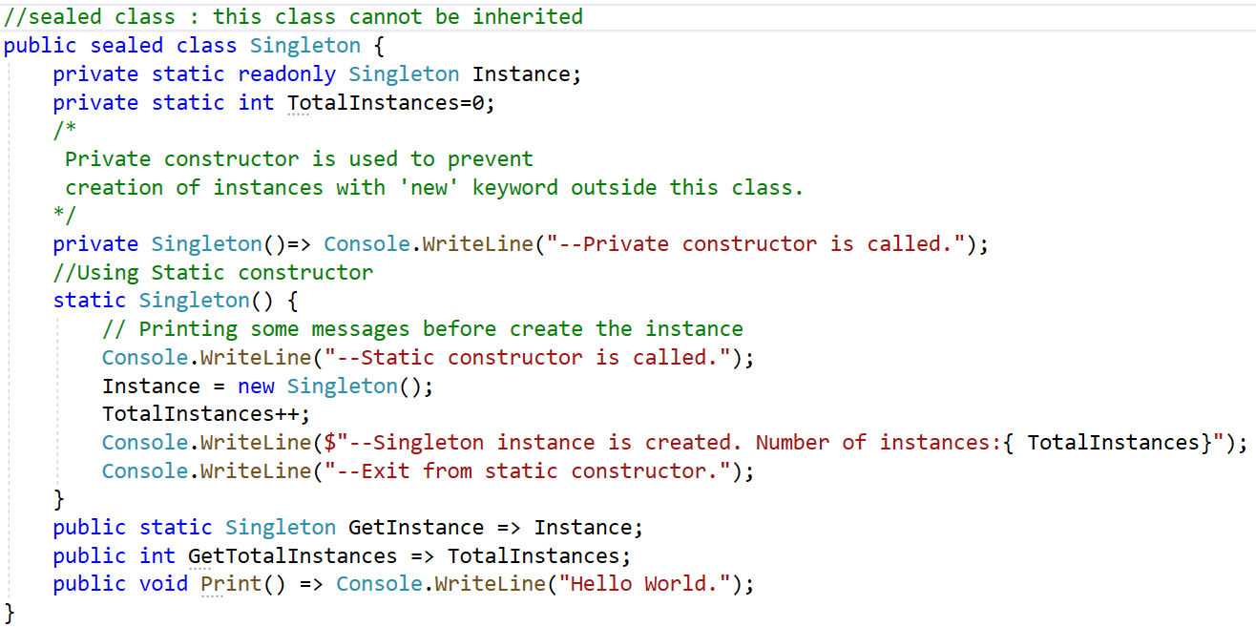
Implement Singleton Pattern

Slide 13
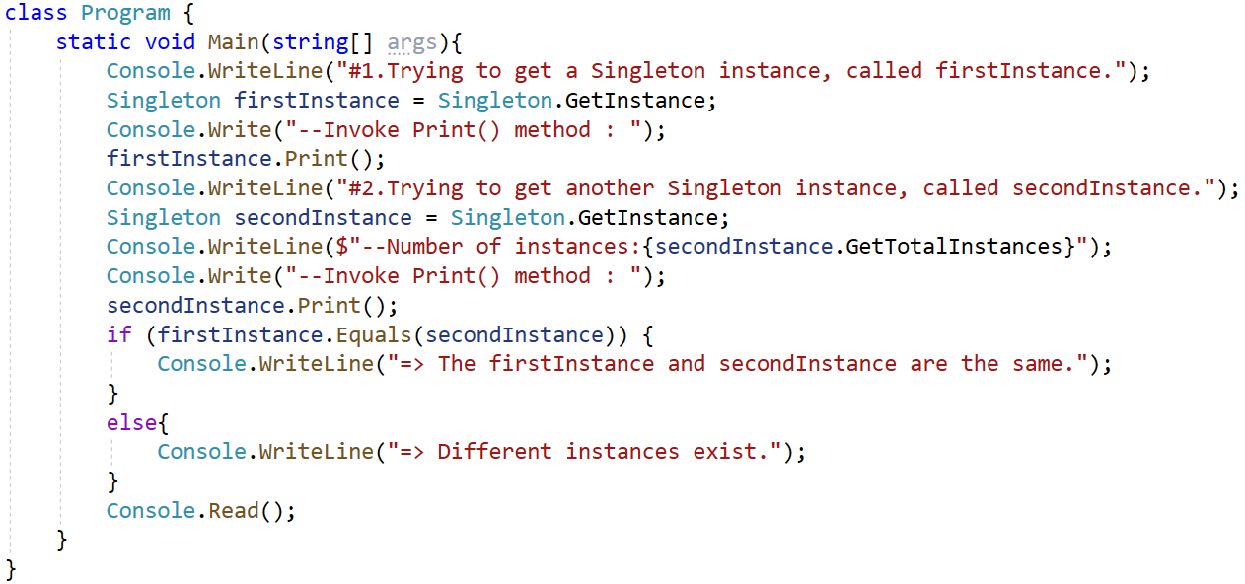
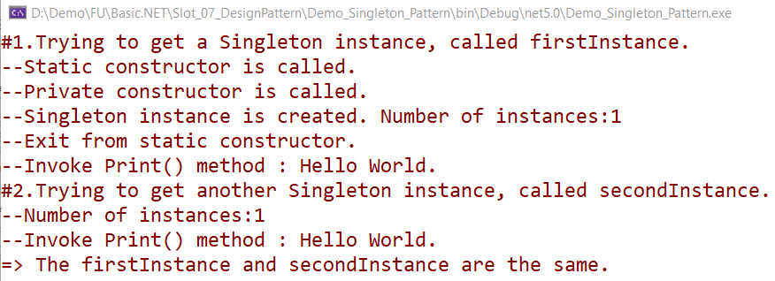
Implement Singleton Pattern

Slide 14
Factories Method Pattern

Slide 15
Factories Method Pattern
Factory method related to object creation. Define an interface for creating an object, but let subclasses decide which class to instantiate
Factory Method lets a class defer instantiation to subclasses
In Factory pattern, we create object without exposing the creation logic to client and the client use the same common interface to create new type of object
The idea is to use a (static) member-function or (static) factory method which creates and returns instances, hiding the details of class modules from user

Slide 16
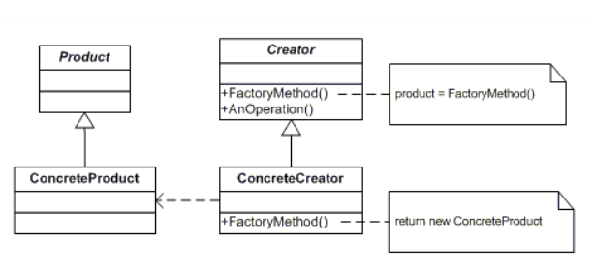
Factories Method Pattern
A factory pattern is one of the core design principles to create an object, allowing clients to create objects of a library in a way such that it doesn’t have tight coupling with the class hierarchy of the library
UML class diagram

Slide 17
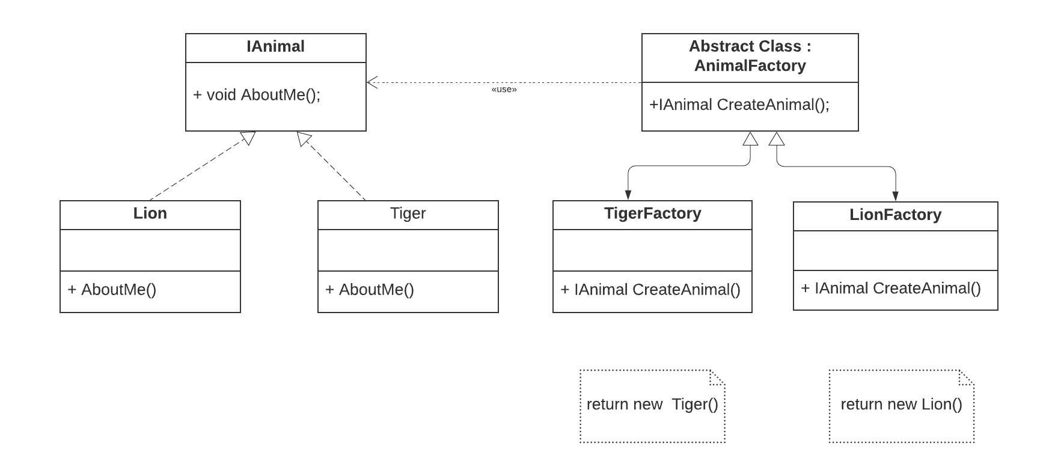
Implement Factories Method
UML class diagram

Slide 18
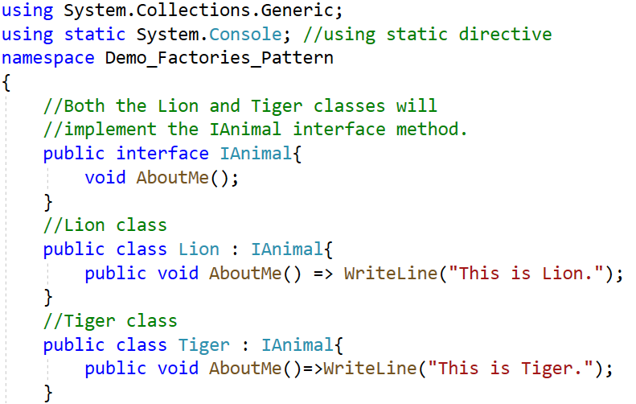
Implement Factories Method

Slide 19
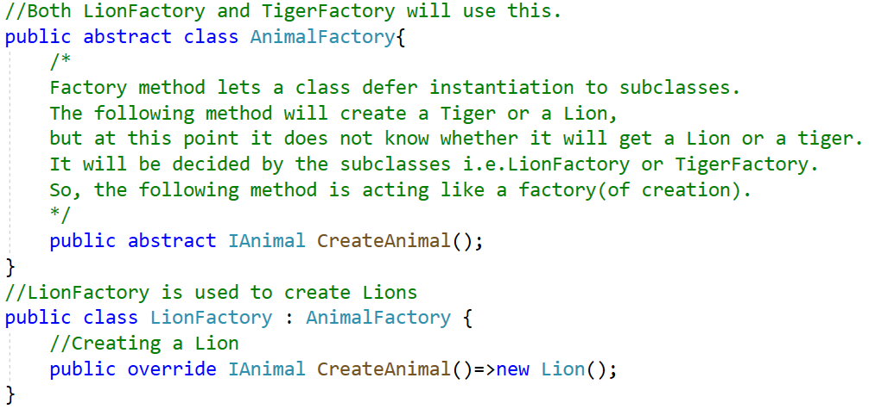
Implement Factories Method

Slide 20
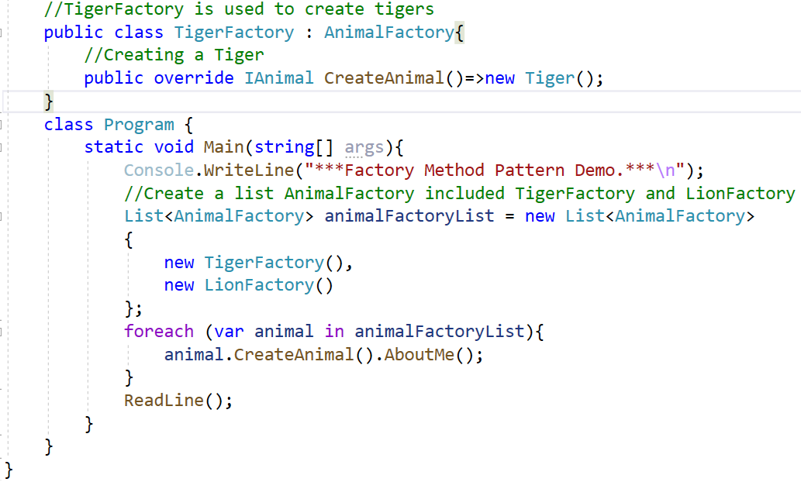
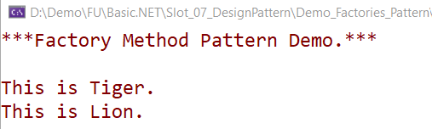
Implement Factories Method

Slide 21
Abstract Factory Pattern

Slide 22
Abstract Factory Patterns
Abstract Factory patterns work around a super-factory which creates other factories
This type of design pattern comes under creational pattern as this pattern provides one of the best ways to create an object
In Abstract Factory pattern an interface is responsible for creating a factory of related objects without explicitly specifying their classes. Each generated factory can give the objects as per the Factory pattern

Slide 23
Abstract Factory Design Pattern Participants
AbstractFactory: declares an interface for operations that create abstract products
ConcreteFactory: implements the operations to create concrete product objects
AbstractProduct: declares an interface for a type of product object
Product: defines a product object to be created by the corresponding concrete factory and implements the AbstractProduct interface
Client: uses interfaces declared by AbstractFactory and AbstractProduct classes

Slide 24
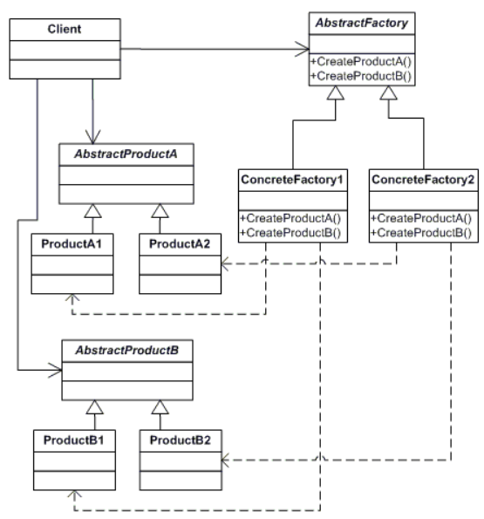
UML class diagram

Slide 25
Builder Pattern

Slide 26
Builder Pattern
Builder pattern aims to “Separate the construction of a complex object from its representation so that the same construction process can create different representations.”
It is used to construct a complex object step by step and the final step will return the object
The process of constructing an object should be generic so that it can be used to create different representations of the same object

Slide 27
Builder Design Pattern Participants
Product – The product class defines the type of the complex object that is to be generated by the builder pattern.
Builder – This abstract base class defines all of the steps that must be taken in order to correctly create a product. Each step is generally abstract as the actual functionality of the builder is carried out in the concrete subclasses. The GetProduct method is used to return the final product. The builder class is often replaced with a simple interface
ConcreteBuilder – There may be any number of concrete builder classes inheriting from Builder. These classes contain the functionality to create a particular complex product

Slide 28
Builder Pattern
Director – The director class controls the algorithm that generates the final product object. A director object is instantiated and its Construct method is called. The method includes a parameter to capture the specific concrete builder object that is to be used to generate the product. The director then calls methods of the concrete builder in the correct order to generate the product object. On completion of the process, the GetProduct method of the builder object can be used to return the product

Slide 29
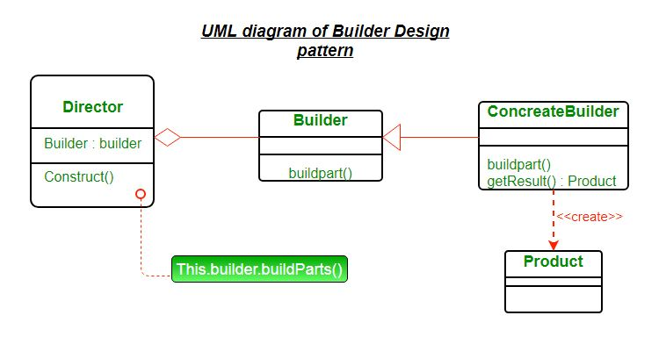
Builder Pattern

Slide 30
Advantages and Disadvantages
Advantages
The parameters to the constructor are reduced and are provided in highly readable method calls
Builder design pattern also helps in minimizing the number of parameters in constructor and thus there is no need to pass in null for optional parameters to the constructor
Object is always instantiated in a complete state
Immutable objects can be build without much complex logic in object building process
Disadvantages
The number of lines of code increase at least to double in builder pattern, but the effort pays off in terms of design flexibility and much more readable code
Requires creating a separate ConcreteBuilder for each different type of Product

Slide 31
Prototype Pattern

Slide 32
Prototype Pattern
The prototype allows us to hide the complexity of making new instances from the client
The concept is to copy an existing object rather than creating a new instance from scratch, something that may include costly operations
The existing object acts as a prototype and contains the state of the object
The newly copied object may change the same properties only if required. This approach saves costly resources and time, especially when object creation is a heavy process

Slide 33
Prototype Pattern
Prototype patterns are required, when object creation is a time-consuming, and costly operation, so we create an object with the existing object itself
One of the best available ways to create an object from existing objects is the clone() method
Clone is the simplest approach to implement a prototype pattern. However, it is our call to decide how to copy existing object based on your business model

Slide 34
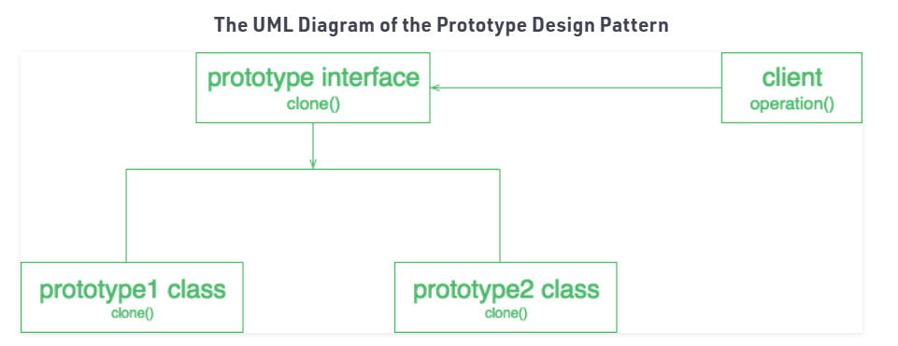
Prototype Design Pattern Participants
Prototype: This is the prototype of the actual object
Prototype registry: This is used as a registry service to have all prototypes accessible using simple string parameters
Client: The client will be responsible for using the registry service to access prototype instances

Slide 35
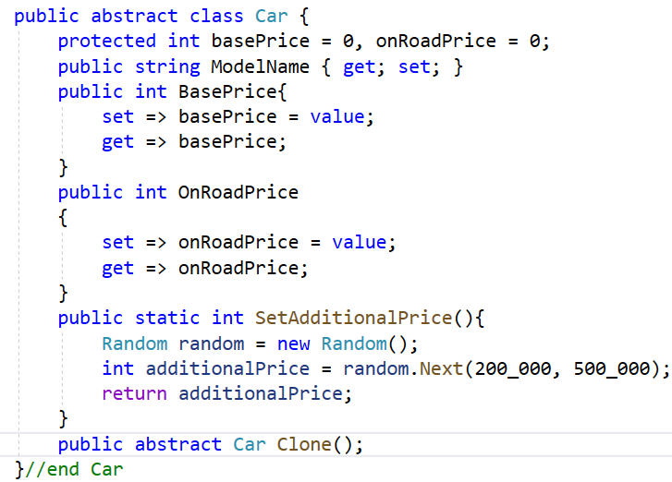
Implement Prototype Pattern

Slide 36
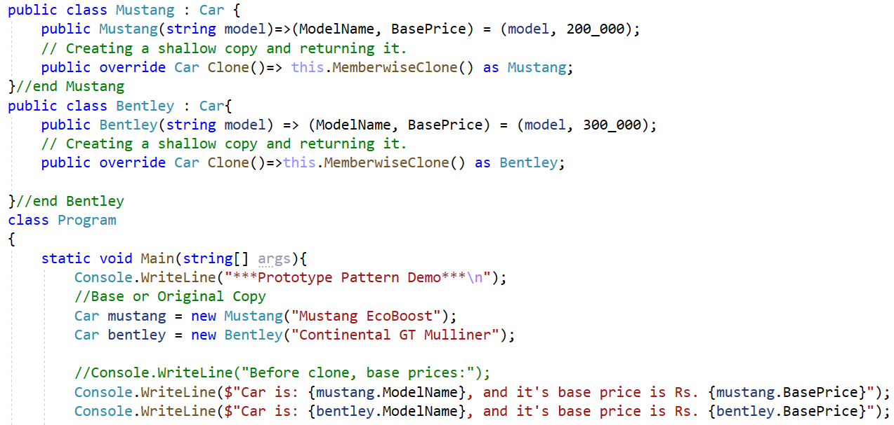
Implement Prototype Pattern

Slide 37
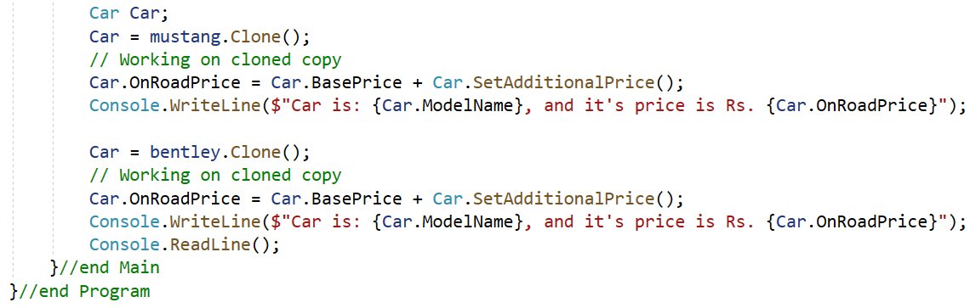
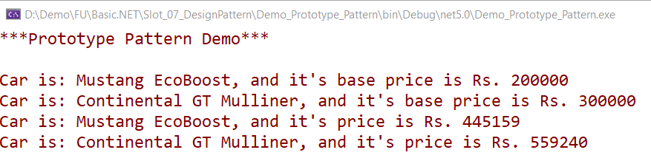
Implement Prototype Pattern

Slide 38
Observer Pattern

Slide 39
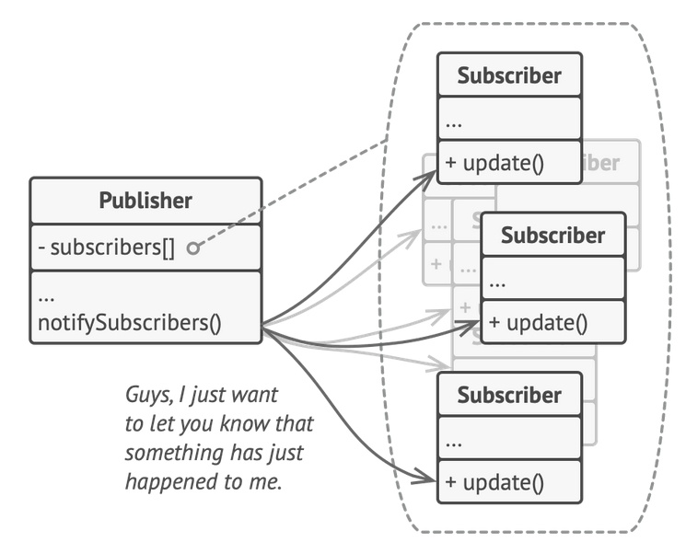
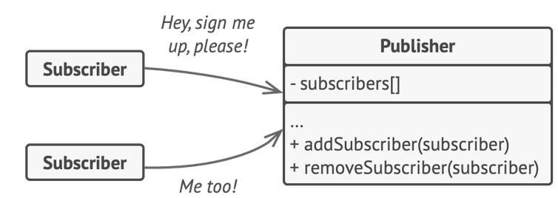
Observer Pattern
The Observer Pattern is a behavioral design pattern that defines a one-to-many dependency between objects so that when one object changes state, all its dependents are notified and updated automatically.
Intent: To decouple the subject (publisher) from its observers (subscribers), allowing for loosely coupled systems.

Slide 40
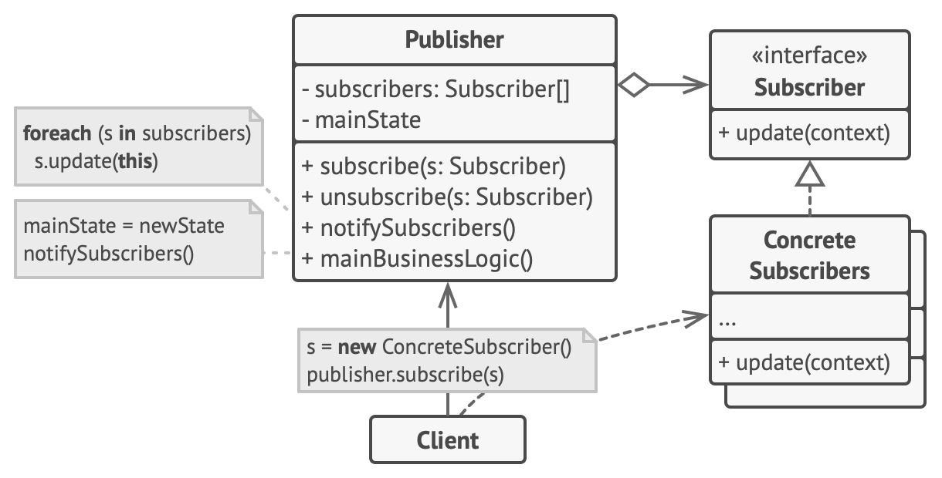
Observer Pattern
UML diagram depicting the structure of the Observer Pattern.
Subject: Represents the publisher that maintains a list of observers and notifies them of changes.
Observer: Defines an interface for objects that should be notified of changes in the subject.
ConcreteSubject: Implements the Subject interface and manages its list of observers.
ConcreteObserver: Implements the Observer interface and receives notifications from the subject.

Slide 41
Observer Pattern
Use the Observer pattern when changes to the state of one object may require changing other objects, and the actual set of objects is unknown beforehand or changes dynamically.
Use the pattern when some objects in your app must observe others, but only for a limited time or in specific cases.
The subscription list is dynamic, so subscribers can join or leave the list whenever they need to.

Slide 42
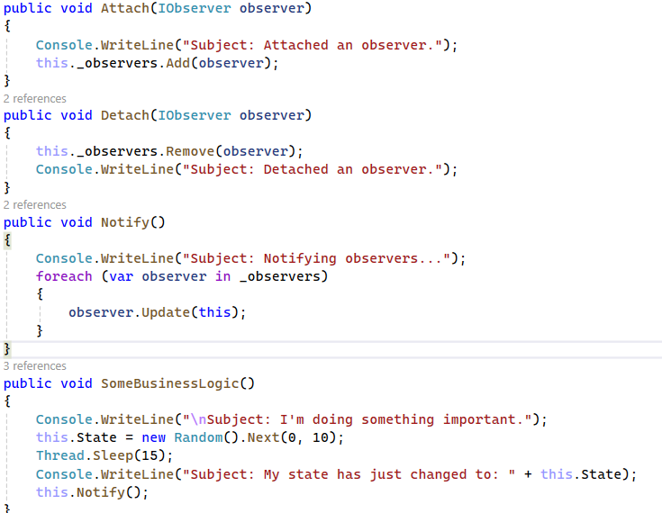
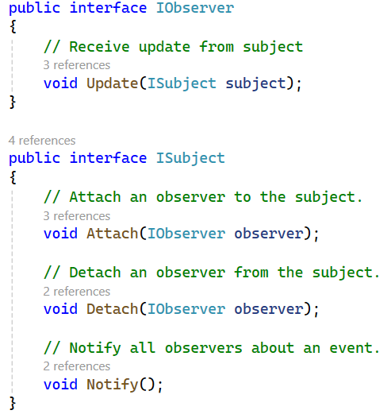
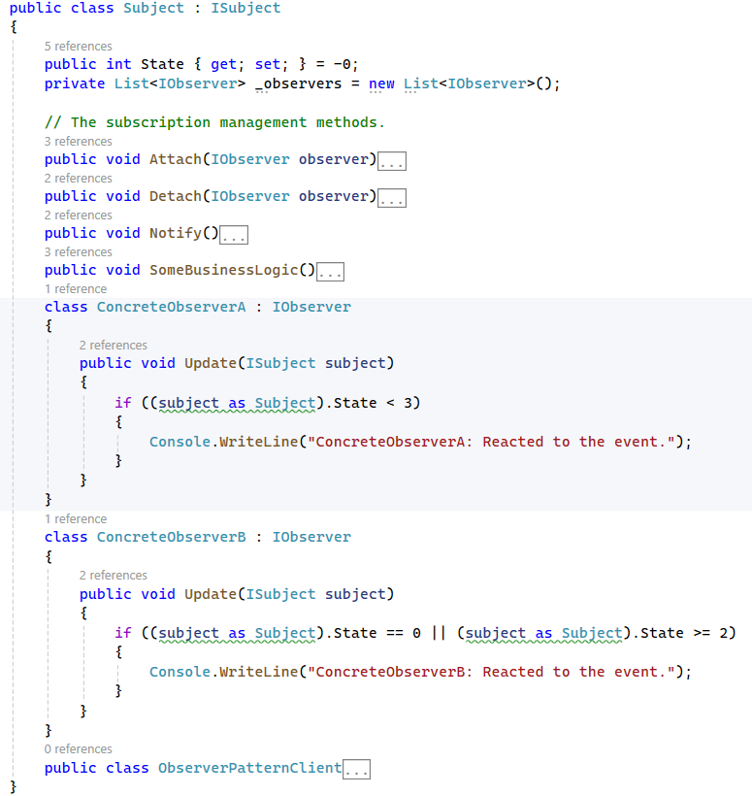
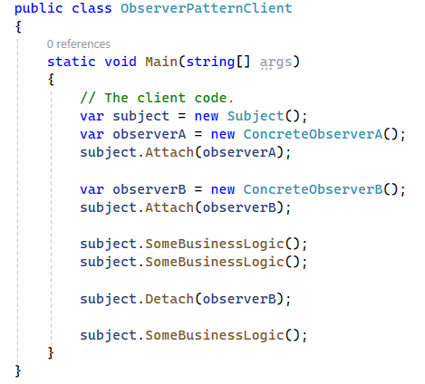
Observer Pattern

Slide 43
Summary
Concepts were introduced:
Overview about Design Pattern in .NET
Why must use Design Pattern?
Explain about Singleton Pattern
Explain about Factories Pattern
Explain about Abstract Factory Pattern
Explain about Builder Pattern
Explain about Prototype Pattern
Demo about Factories Method, Prototype Pattern and Singleton Pattern in .NET applications

